Slide 1

Programming Two (csc7051)
Aidan McGowan
ArrayList

Slide 2

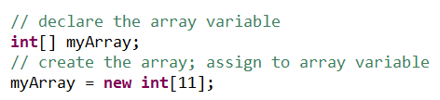
Recall arrays !
Standard Java arrays are of a fixed length.
After arrays are created, they cannot grow or shrink, which means that you must know in advance how many elements an array will hold.

Slide 3
Collections API
The Java API provides several predefined data structures, called collections, used to store groups of related objects. These classes provide efficient methods that organise, store and retrieve your data without requiring knowledge of how the data is being stored. This reduces application-development time.
The java.util is where you will find the ArrayList.

Slide 4

The ArrayList
The ArrayList class extends AbstractList and implements the List interface.
ArrayList supports dynamic arrays that can grow as needed.
Technically speaking, ArrayList is like a dynamic array or a variable-length array.

Slide 5
The ArrayList
Array lists are created with an initial capacity (defaulted to 10)
When this size is exceeded, the collection is automatically enlarged (reallocation)
When objects are removed, the array may be shrunk.

Slide 6
Creating an ArrayList
The ArrayList class supports three constructors.
The first constructor builds an empty array list.
ArrayList( ) (size 0 but capacity 10)
2. The following constructor builds an array list that is initialised with the elements of the collection c.
ArrayList(Collection c)
Building an array list that has the specified initial capacity. The capacity is the size of the underlying array that is used to store the elements.
ArrayList(int capacity)

Slide 7
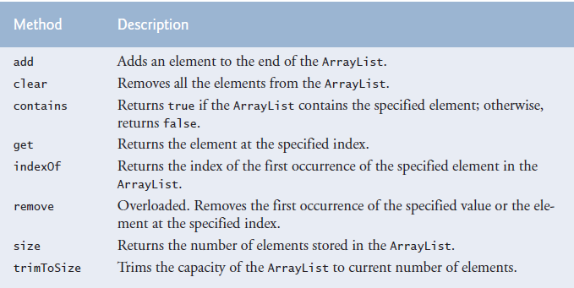
Common ArrayList methods

Slide 8

Declaring an ArrayList
To use it you need to import it …
Declaration …. (in this case an ArrayList of Strings)
Note : ArrayLists don’t support primitive types

Slide 9
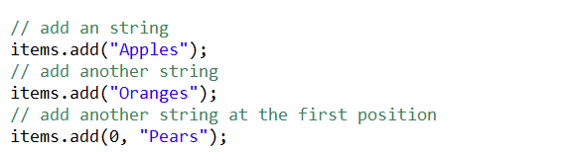

Adding an item … add()
(Size = number of items)
Size of arraylist 3
[Pears, Apples, Oranges]

Slide 10

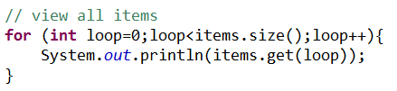
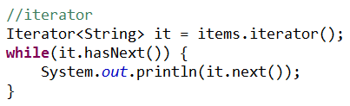
Looping through .. 3 ways
Notes:
Standard FOR loop - good if you need the index value
FOREACH – good to go through but not remove items
Iterator – good if you don’t have the index but still need to remove an item

Slide 11
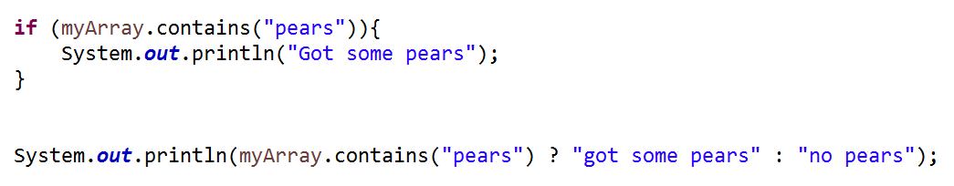
Search for …. contains()
Got some pears
got some pears

Slide 12
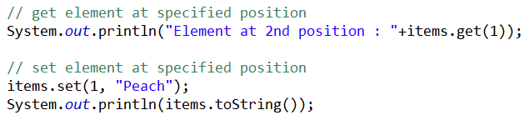
Gets and Sets
Element at 2nd position : Apples
[Pears, Peach, Oranges]

Slide 13
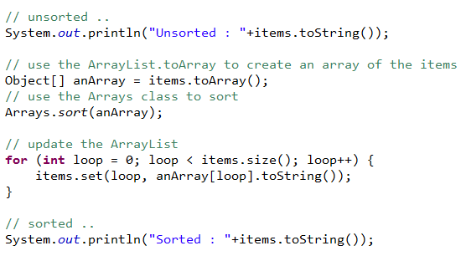
Sorting an ArrayList
Unsorted : [Pears, Peach, Oranges]
Sorted : [Oranges, Peach, Pears]

Slide 14

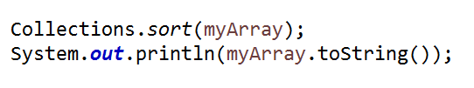
Or…

Slide 15
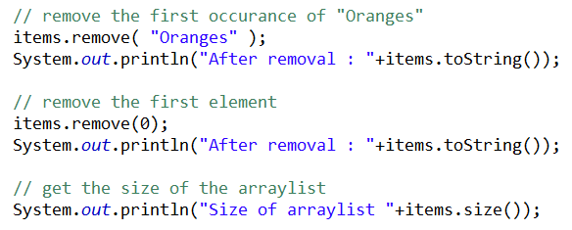
Remove items … remove()
After removal : [Peach, Pears]
After removal : [Pears]
Size of arraylist 1

Slide 16
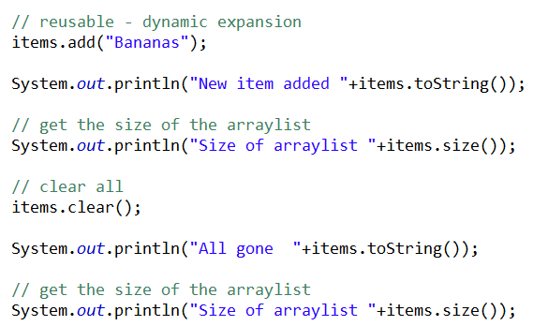

Dynamic sizing and clearing

Slide 17
ArrayList sizing
size = 3
E x p a n s I o n s p a c e ………………..
Apples | Oranges | Pears
capacity
At any point the ArrayList occupies a contiguous block of memory that holds the existing items and some expansion space.
The number of actual elements is the size (returned by the size() method).
The total number of possible elements is the capacity.
The program may use the add() method to add until all the capacity in the memory block is used up. At that stage in order to continue to expand the ArrayList’s contents are copied to another larger memory location (reallocation)

Slide 18
ArrayList sizing - controlling
The runtime efficiency is better if the reallocation is kept to an minimum.
ensureCapacity(int minCapacity) - allocates a block of memory with the specified minimum size.
trimToSize() – trims the capacity of the current ArrayList to its size.

Slide 19
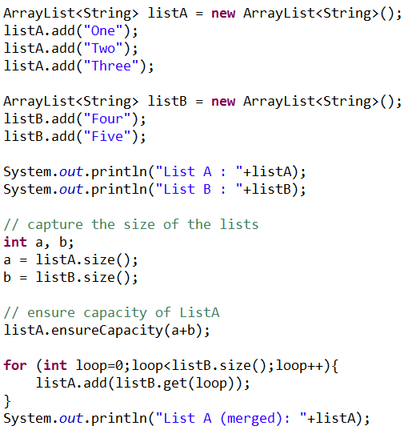
Demo .. Merging two ArrayLists
List A : [One, Two, Three]
List B : [Four, Five]
List A (merged): [One, Two, Three, Four, Five]

Slide 20
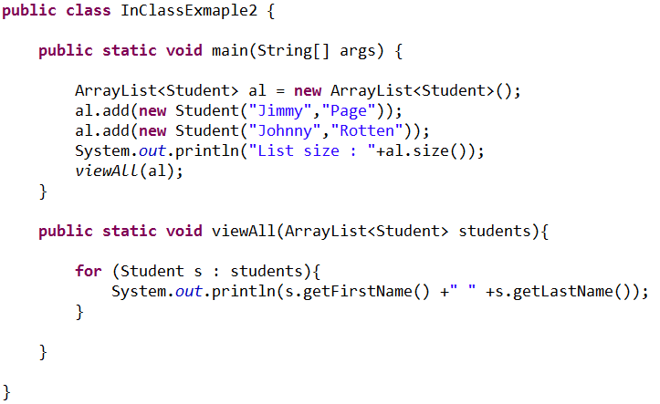
Passing an ArrayList as a parameter

Slide 21
Exercise I
Create a class that has the following method signatures.
JUnit Test these methods…
Notes:
public class Exercise2 {
public static void sort(ArrayList<String> ar) {
Object[] obs = ar.toArray();
Arrays.sort(obs);
// transfer back to an arraylist
for (int loop = 0; loop < obs.length; loop++) {
ar.set(loop, (String) obs[loop]);
}
}
public static ArrayList<String> merge(ArrayList<String> list1, ArrayList<String> list2) {
ArrayList<String> merged = new ArrayList<>();
for (int loop=0;loop<list1.size();loop++){
merged.add(list1.get(loop));
}
for (int loop=0;loop<list2.size();loop++){
merged.add(list2.get(loop));
}
return merged;
}
}
____________________________________________________________________________________________________________________
public class TestMergeredSorted {
String usa;
String germany;
String canada;
String sweden;
ArrayList<String> l1;
ArrayList<String> l2;
@Before
public void setUp() throws Exception {
l1 = new ArrayList<>();
l2 = new ArrayList<>();
usa = "usa";
germany = "germany";
canada = "canada";
sweden = "sweden";
l1.add(usa);
l1.add(canada);
l2.add(sweden);
l2.add(germany);
}
@Test
public void testSort() {
boolean flag = false;
System.out.println(l1.toString());
Exercise2.sort(l1);
System.out.println(l1.toString());
// check if order is as expected
if ((l1.get(0).equals(canada)) && (l1.get(1).equals(usa))) {
flag = true;
}
assertTrue(flag);
}
@Test
public void testMerge() {
boolean flag = false;
ArrayList<String> merged = Exercise2.merge(l1, l2);
if ((merged.contains(canada)) && (merged.contains(usa))
&& (merged.contains(sweden)) && (merged.contains(germany))) {
flag = true;
}
assertTrue(flag);
}
}

